Slide 1
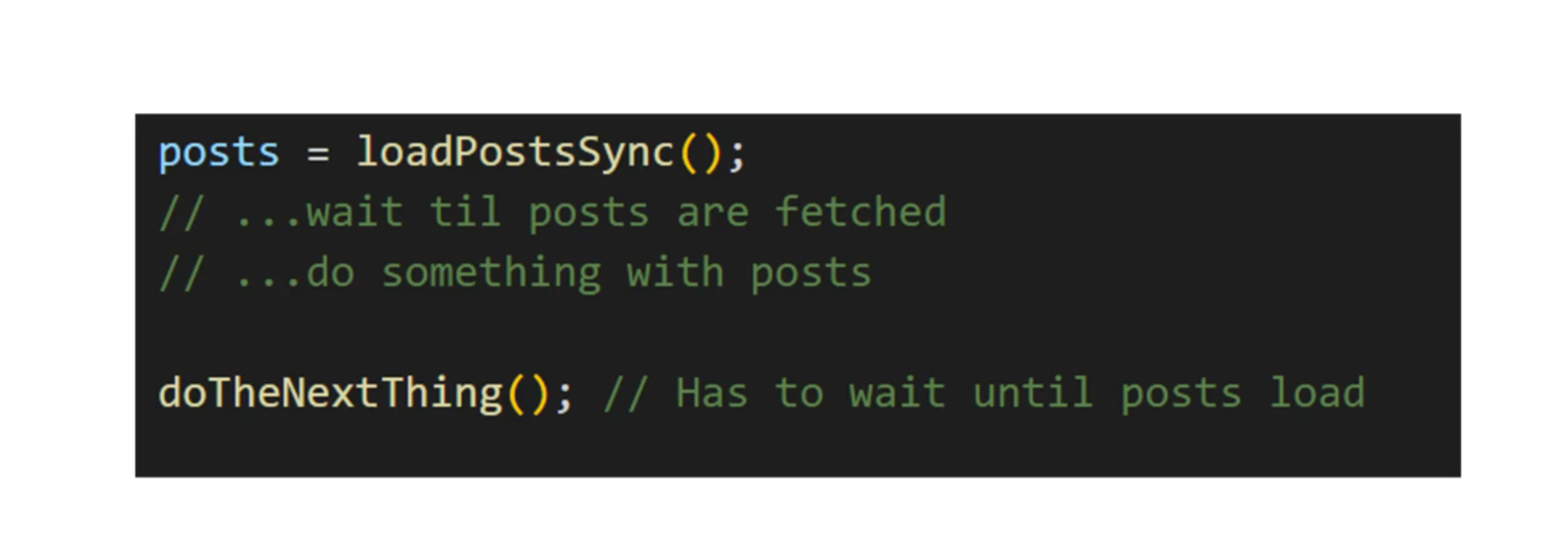
Synchronous code

Slide 2
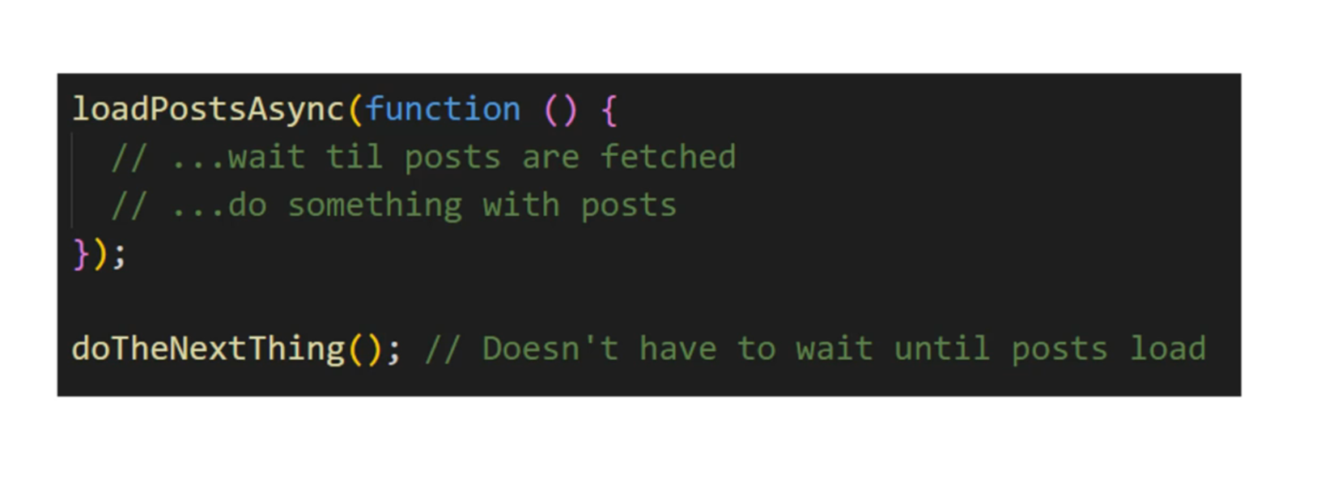
Asynchronous code

Slide 3
Handling Async Code
CallBacks
Promises
Async / Await

Slide 4
Ajax
Asynchronous Javascript and XML
Set of web technologies (not a library or framework)
Send and receive data asynchronously.
Does not need for page to reload (making it faster)
JSON has replaced XML.

Slide 5
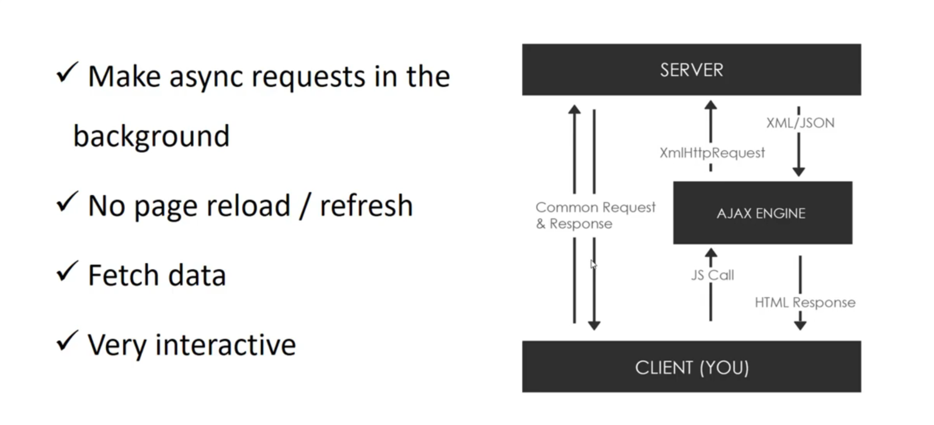
How it works?

Slide 6
XMLHTTP Object
API in the form of an object.
Provided by the JS environment
Methods transfer data between client and server.
Can be used with other protocols other than HTTP.
Can work with other data types. (JSON , plain text, etc)

Slide 7
What is an API?
Application Programming Interface.
Contract provided by one piece of software to another
Structured request and response.
Chuck norris jokes = WEB API that takes a request and responds with a joke.

Slide 8
What is REST?
Representation State Transfer
Architecture style for designing network applications
Relies on a stateless, client-server protocol
Treats server objects as resources that can be created or destroyed.
Can be used with virtually any programming language
All API have their own rules and structure.

Slide 9
To sum up:
API = IS the messenger
REST = allows us to structure this message in a particular standard way.

Slide 10
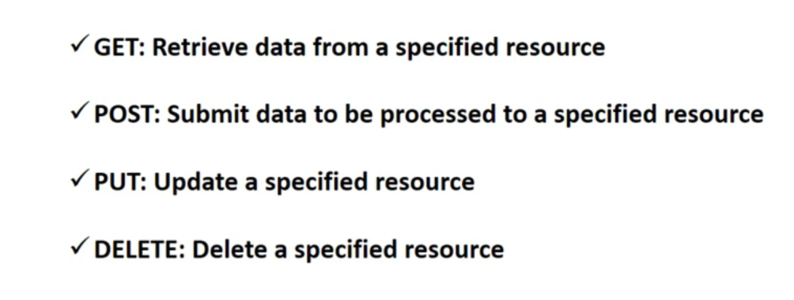
HTTP Requests

Slide 11
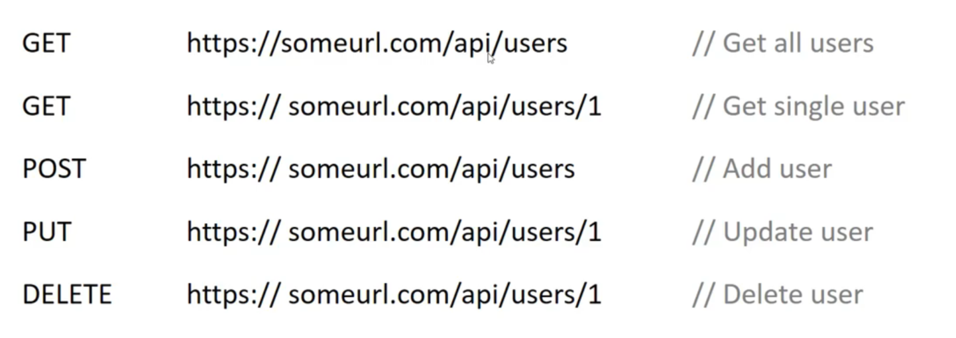
API Endpoints
URL’s that allow us to do specific things

Slide 12
What are Promises?
Promises are alternatives to callbacks
ES6 way of handling asynchronous code
While handling async code, promises can essentially “promise” to do something when the async code is finished. (essentially like a callback)
.then().catch() → syntax for Promise writing

Slide 13
Fetch API
Part of the Window object
Returns a promise
A replacement and a newer standard compared to xmlhttp req object

